Slide 1
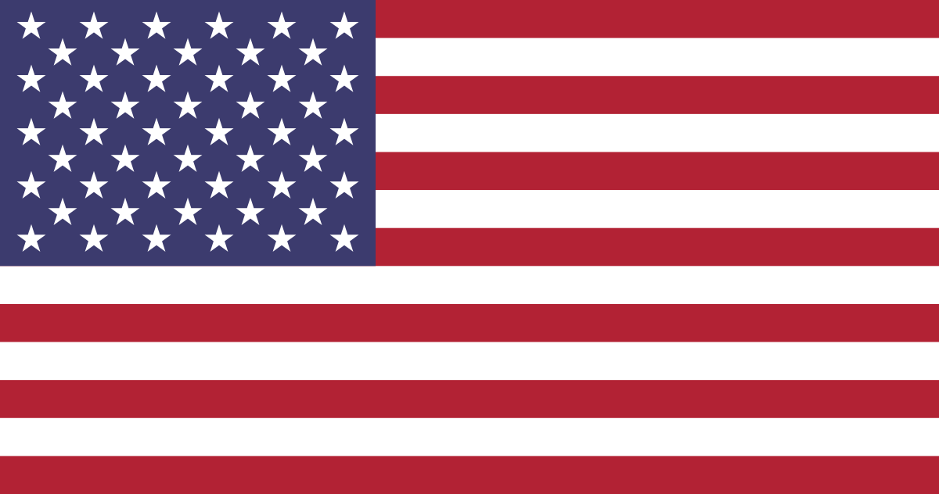

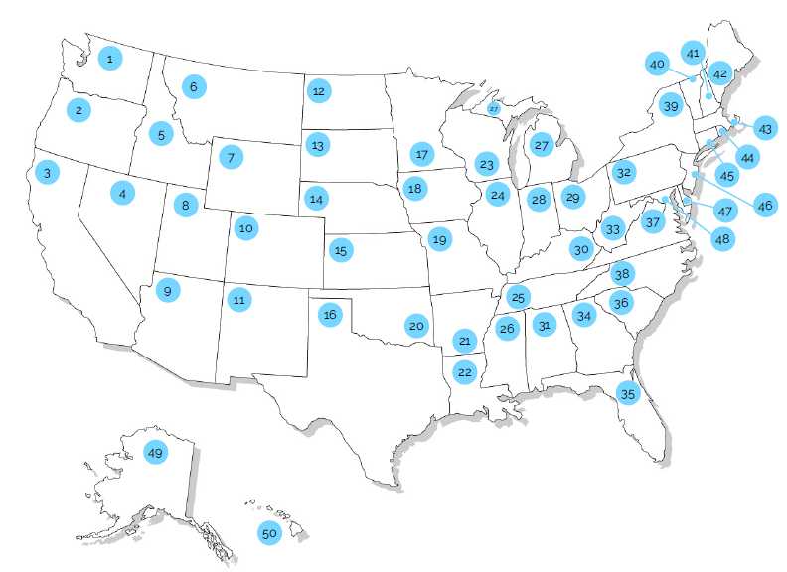






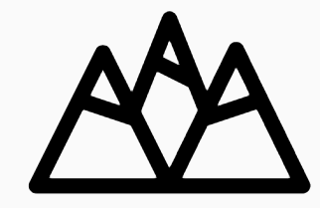




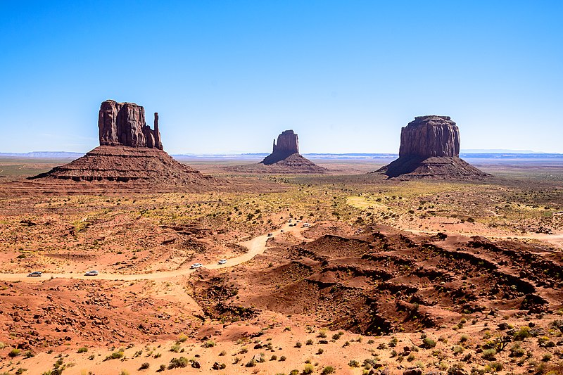
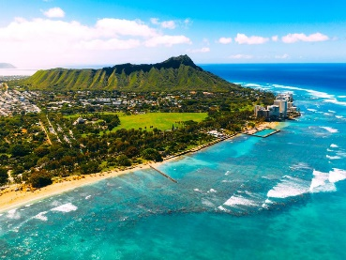
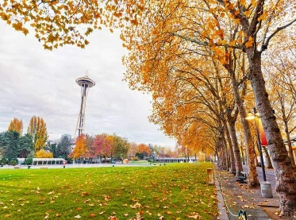

The Americas: USA!
Key Vocabulary:
States
biome
Capital
Climate
Diverse
Landscape
National park
State
Terrain
Urbanisation
The USA is made up of 50 states. Washington, DC is the capital city. The USA is the third-largest country in the world by area. The USA contains a wide range of climates, landscapes and biomes. More than 330 million people live in the USA.
National animals: Bald Eagle, American Bison.
A large area of the world with a similar climate, plants and animals.
A city where a country’s government is located.
Washington, DC is the capital city of the USA but doesn’t belong to a state.
The average weather of an area over a long period of time.
The President is the elected leader of the United States. George Washington was the first president in 1789. Donald Trump became the 47th president of the United States.
Very different.
What the land looks like, including its physical and human features.
The USA is split into 50 different areas called states. Each state has its own capital city along with its own laws and government. However, they are still part of the federal government of the United States.
A protected area of land that is preserved because of its natural beauty, wildlife or important landscapes.
Physical features
Grand Canyon (AZ)
Niagara Falls (NY)
Climate zones
The USA has a range of climate zones including these below:
Glacier National Park (MT)
One of the 50 regions that make up the United States, each with its own government.
Arid = Hot and dry all year. 2 seasons. Cold during winter nights
Temperate = Rainfall all year. 4 seasons. Mild winters and summers.
Tropical = Warm and wet all year.
An area of land with physical features. (rough, flat etc.)
Human features
Monument Valley (Arid)
Honolulu (Tropical)
Seattle (Temperate)
Golden Gate Bridge (CA)
Statue of Liberty (NY)
The White House (DC)
Movement of people from rural to urban areas.

